Slide 1


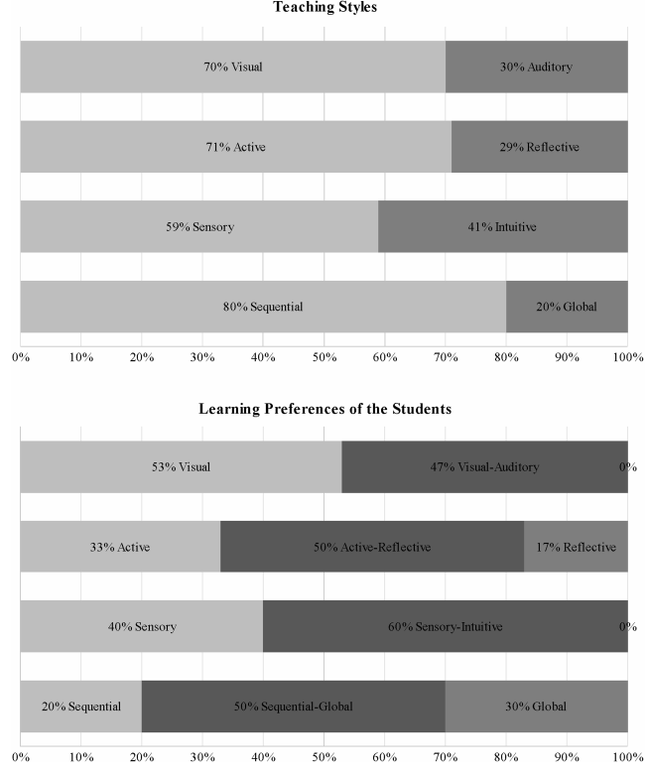
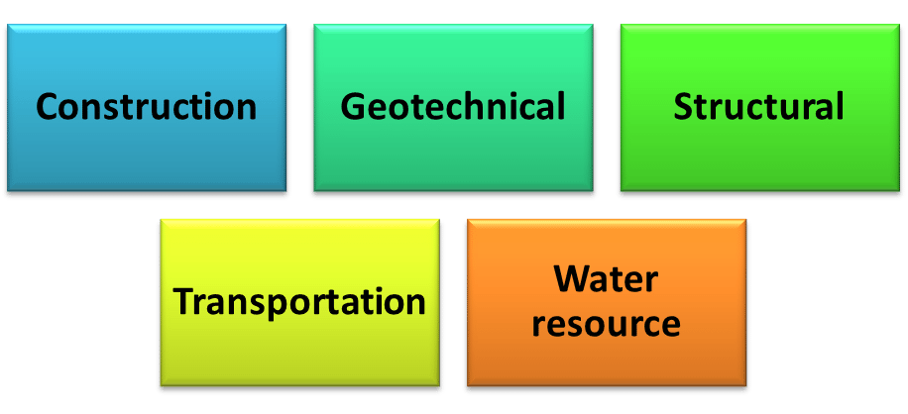
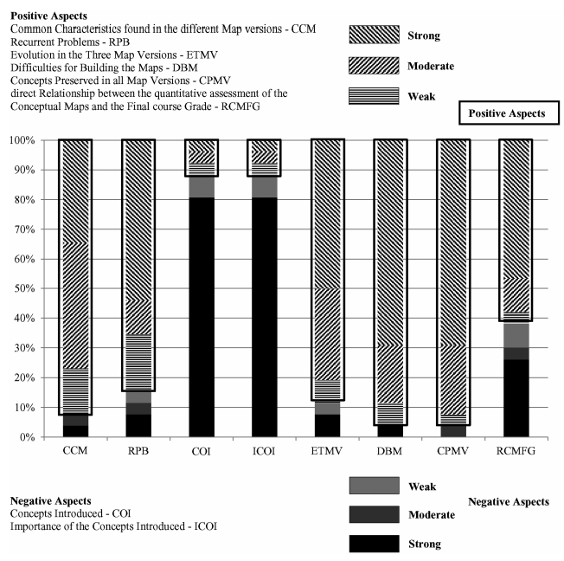
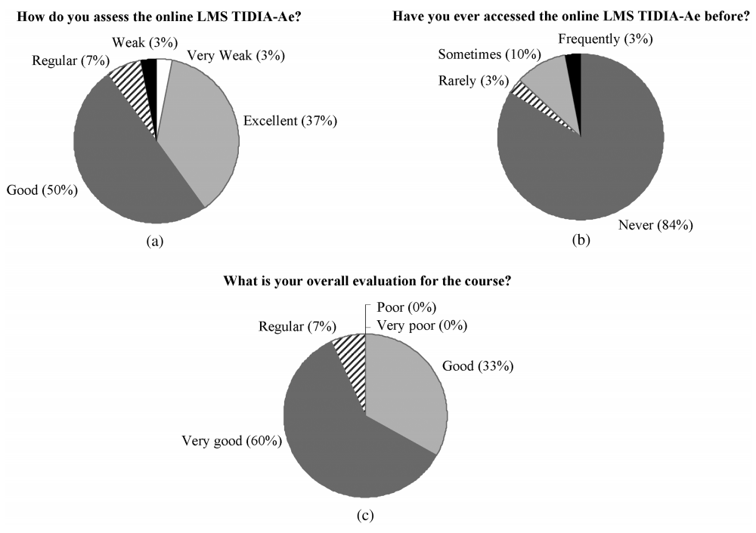
Transportation Engineering Education for Undergraduate Students: Competencies, Skills, Teaching-Learning, and Evaluation
Carlos Alberto Prado da Silva Jr.; Heliana Barbosa Fontenele; Antônio Nélson Rodrigues da Silva
Presented by Somdut Roy for CETL-8713, Spring 2021
Introduction
Civil Engineering
Problems for Transportation Professionals
Most Transportation professionals have bachelor degree in Civil Engineering, only a few take up dedicated graduate studies
Issues with Bachelor curriculum
Inflexible and non-dedicated Curriculum: Curriculum needs to be more flexible, more specific approach in the first years of education
Insufficient “Specialization-specific” Literature: Project and management of transportations systems not covered in texts
Case Study
. The study was performed on a set of courses at University of São Paulo at São Carlos (EESC-USP), Brazil
Resources Applied in the Classroom
Active Learning
An online platform was developed: Learning Management System (LMS) TIDIA Ae
Teaching Style vs Learning Style Preference
Expositive Classes:
Oral presentation
Slideshows
Blackboard Lecture
Guided Computer Lab
Minute Papers:
The students were asked to register, immediately after the classes
They note down topics useful to them
The notes were analyzed
The most relevant points were brought back by the lecturer in subsequent classes.
Analyze
Plan
Do
Review
Constant Questioning:
The lecturer asked students to answer short and direct questions related to the topics discussed during the classes.
The first student selected was then asked to select another student to answer the following question, and so on.
Teamwork:
Groups for small tasks like:
Elaboration of graphs
Resolution of numerical exercises
Construction of simple mathematical models
Tasks were 5-10 min long
Team of two; students take turn to present
Evaluation of Concept Map
Dedicated Courses |  | Experimental Teaching
Set of courses selected to provide focus on Transportation Engineering. |  | Emphasis on teaching-learning strategies for the courses and studying the effectiveness of it
Limitations of Current Study
Questionable universal applicability: Study performed on a limited number of course
Lack of repetition of the experimental learning: Need to do it for considerable amount of time
Difficulty in covering more concepts: As seen in concept map evaluation, student can be introduced to limited number of new concepts under current setting.
Notes:
Hello, today we will be discussing a way of teaching Transportation Engineering for Bachelor students as implemented in University of Sao Paolo.

Slide 2
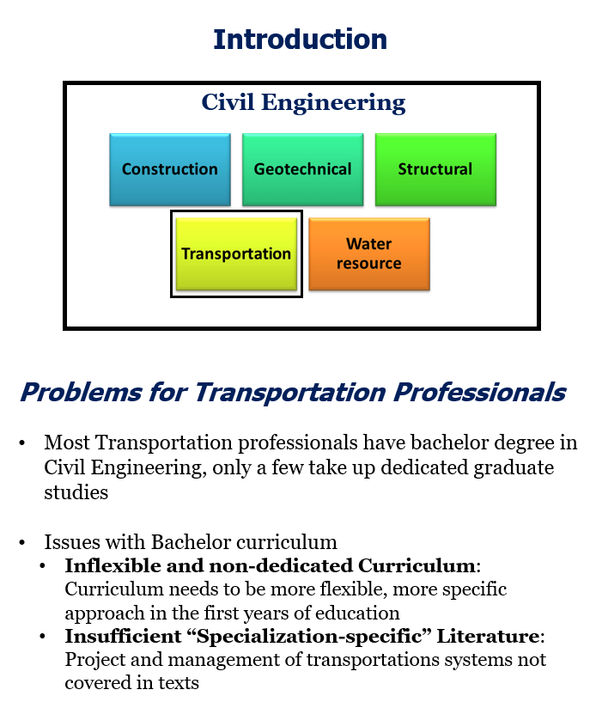
Transportation Engineering Education for Undergraduate Students: Competencies, Skills, Teaching-Learning, and Evaluation
Carlos Alberto Prado da Silva Jr.; Heliana Barbosa Fontenele; Antônio Nélson Rodrigues da Silva
Presented by Somdut Roy for CETL-8713, Spring 2021
Introduction
Civil Engineering
Problems for Transportation Professionals
Most Transportation professionals have bachelor degree in Civil Engineering, only a few take up dedicated graduate studies
Issues with Bachelor curriculum
Inflexible and non-dedicated Curriculum: Curriculum needs to be more flexible, more specific approach in the first years of education
Insufficient “Specialization-specific” Literature: Project and management of transportations systems not covered in texts
Case Study
. The study was performed on a set of courses at University of São Paulo at São Carlos (EESC-USP), Brazil
Resources Applied in the Classroom
Active Learning
An online platform was developed: Learning Management System (LMS) TIDIA Ae
Teaching Style vs Learning Style Preference
Expositive Classes:
Oral presentation
Slideshows
Blackboard Lecture
Guided Computer Lab
Minute Papers:
The students were asked to register, immediately after the classes
They note down topics useful to them
The notes were analyzed
The most relevant points were brought back by the lecturer in subsequent classes.
Analyze
Plan
Do
Review
Constant Questioning:
The lecturer asked students to answer short and direct questions related to the topics discussed during the classes.
The first student selected was then asked to select another student to answer the following question, and so on.
Teamwork:
Groups for small tasks like:
Elaboration of graphs
Resolution of numerical exercises
Construction of simple mathematical models
Tasks were 5-10 min long
Team of two; students take turn to present
Evaluation of Concept Map
Dedicated Courses |  | Experimental Teaching
Set of courses selected to provide focus on Transportation Engineering. |  | Emphasis on teaching-learning strategies for the courses and studying the effectiveness of it
Limitations of Current Study
Questionable universal applicability: Study performed on a limited number of course
Lack of repetition of the experimental learning: Need to do it for considerable amount of time
Difficulty in covering more concepts: As seen in concept map evaluation, student can be introduced to limited number of new concepts under current setting.
Notes:
Civil Engineering in itself has multiple sub-disciplines that are very distinct from one another. So, a student with a bachelor degree going into a transportation profession will not have the specific skill sets that the job entails. Also, not many transportation professionals take up graduate studies before joining.
There are two glaring issues with the bachelor curriculum. Firstly, the curriculum is too rigid for specialization and add to that we generally have too much scope for transportation related literature.

Slide 3
Transportation Engineering Education for Undergraduate Students: Competencies, Skills, Teaching-Learning, and Evaluation
Carlos Alberto Prado da Silva Jr.; Heliana Barbosa Fontenele; Antônio Nélson Rodrigues da Silva
Presented by Somdut Roy for CETL-8713, Spring 2021
Introduction
Civil Engineering
Problems for Transportation Professionals
Most Transportation professionals have bachelor degree in Civil Engineering, only a few take up dedicated graduate studies
Issues with Bachelor curriculum
Inflexible and non-dedicated Curriculum: Curriculum needs to be more flexible, more specific approach in the first years of education
Insufficient “Specialization-specific” Literature: Project and management of transportations systems not covered in texts
Case Study
. The study was performed on a set of courses at University of São Paulo at São Carlos (EESC-USP), Brazil
Resources Applied in the Classroom
Active Learning
An online platform was developed: Learning Management System (LMS) TIDIA Ae
Teaching Style vs Learning Style Preference
Expositive Classes:
Oral presentation
Slideshows
Blackboard Lecture
Guided Computer Lab
Minute Papers:
The students were asked to register, immediately after the classes
They note down topics useful to them
The notes were analyzed
The most relevant points were brought back by the lecturer in subsequent classes.
Analyze
Plan
Do
Review
Constant Questioning:
The lecturer asked students to answer short and direct questions related to the topics discussed during the classes.
The first student selected was then asked to select another student to answer the following question, and so on.
Teamwork:
Groups for small tasks like:
Elaboration of graphs
Resolution of numerical exercises
Construction of simple mathematical models
Tasks were 5-10 min long
Team of two; students take turn to present
Evaluation of Concept Map
Dedicated Courses |  | Experimental Teaching
Set of courses selected to provide focus on Transportation Engineering. |  | Emphasis on teaching-learning strategies for the courses and studying the effectiveness of it
Limitations of Current Study
Questionable universal applicability: Study performed on a limited number of course
Lack of repetition of the experimental learning: Need to do it for considerable amount of time
Difficulty in covering more concepts: As seen in concept map evaluation, student can be introduced to limited number of new concepts under current setting.

Slide 4
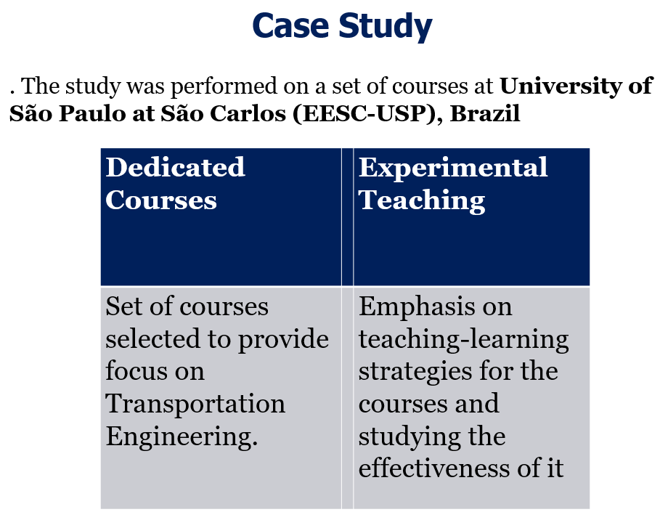
Transportation Engineering Education for Undergraduate Students: Competencies, Skills, Teaching-Learning, and Evaluation
Carlos Alberto Prado da Silva Jr.; Heliana Barbosa Fontenele; Antônio Nélson Rodrigues da Silva
Presented by Somdut Roy for CETL-8713, Spring 2021
Introduction
Civil Engineering
Problems for Transportation Professionals
Most Transportation professionals have bachelor degree in Civil Engineering, only a few take up dedicated graduate studies
Issues with Bachelor curriculum
Inflexible and non-dedicated Curriculum: Curriculum needs to be more flexible, more specific approach in the first years of education
Insufficient “Specialization-specific” Literature: Project and management of transportations systems not covered in texts
Case Study
. The study was performed on a set of courses at University of São Paulo at São Carlos (EESC-USP), Brazil
Resources Applied in the Classroom
Active Learning
An online platform was developed: Learning Management System (LMS) TIDIA Ae
Teaching Style vs Learning Style Preference
Expositive Classes:
Oral presentation
Slideshows
Blackboard Lecture
Guided Computer Lab
Minute Papers:
The students were asked to register, immediately after the classes
They note down topics useful to them
The notes were analyzed
The most relevant points were brought back by the lecturer in subsequent classes.
Analyze
Plan
Do
Review
Constant Questioning:
The lecturer asked students to answer short and direct questions related to the topics discussed during the classes.
The first student selected was then asked to select another student to answer the following question, and so on.
Teamwork:
Groups for small tasks like:
Elaboration of graphs
Resolution of numerical exercises
Construction of simple mathematical models
Tasks were 5-10 min long
Team of two; students take turn to present
Evaluation of Concept Map
Dedicated Courses |  | Experimental Teaching
Set of courses selected to provide focus on Transportation Engineering. |  | Emphasis on teaching-learning strategies for the courses and studying the effectiveness of it
Limitations of Current Study
Questionable universal applicability: Study performed on a limited number of course
Lack of repetition of the experimental learning: Need to do it for considerable amount of time
Difficulty in covering more concepts: As seen in concept map evaluation, student can be introduced to limited number of new concepts under current setting.
Notes:
Today we will be going through results from transportation related elective courses taught in University of Sao Paolo. There are two parts to it. One is the designing of transportation-specific course, and the other is using innovative teaching-learning strategies.

Slide 5
Transportation Engineering Education for Undergraduate Students: Competencies, Skills, Teaching-Learning, and Evaluation
Carlos Alberto Prado da Silva Jr.; Heliana Barbosa Fontenele; Antônio Nélson Rodrigues da Silva
Presented by Somdut Roy for CETL-8713, Spring 2021
Introduction
Civil Engineering
Problems for Transportation Professionals
Most Transportation professionals have bachelor degree in Civil Engineering, only a few take up dedicated graduate studies
Issues with Bachelor curriculum
Inflexible and non-dedicated Curriculum: Curriculum needs to be more flexible, more specific approach in the first years of education
Insufficient “Specialization-specific” Literature: Project and management of transportations systems not covered in texts
Case Study
. The study was performed on a set of courses at University of São Paulo at São Carlos (EESC-USP), Brazil
Resources Applied in the Classroom
Active Learning
An online platform was developed: Learning Management System (LMS) TIDIA Ae
Teaching Style vs Learning Style Preference
Expositive Classes:
Oral presentation
Slideshows
Blackboard Lecture
Guided Computer Lab
Minute Papers:
The students were asked to register, immediately after the classes
They note down topics useful to them
The notes were analyzed
The most relevant points were brought back by the lecturer in subsequent classes.
Analyze
Plan
Do
Review
Constant Questioning:
The lecturer asked students to answer short and direct questions related to the topics discussed during the classes.
The first student selected was then asked to select another student to answer the following question, and so on.
Teamwork:
Groups for small tasks like:
Elaboration of graphs
Resolution of numerical exercises
Construction of simple mathematical models
Tasks were 5-10 min long
Team of two; students take turn to present
Evaluation of Concept Map
Dedicated Courses |  | Experimental Teaching
Set of courses selected to provide focus on Transportation Engineering. |  | Emphasis on teaching-learning strategies for the courses and studying the effectiveness of it
Limitations of Current Study
Questionable universal applicability: Study performed on a limited number of course
Lack of repetition of the experimental learning: Need to do it for considerable amount of time
Difficulty in covering more concepts: As seen in concept map evaluation, student can be introduced to limited number of new concepts under current setting.

Slide 6
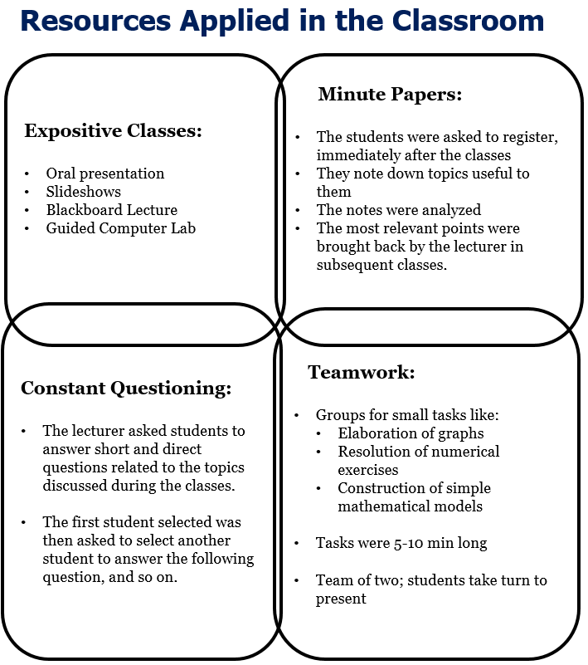
Transportation Engineering Education for Undergraduate Students: Competencies, Skills, Teaching-Learning, and Evaluation
Carlos Alberto Prado da Silva Jr.; Heliana Barbosa Fontenele; Antônio Nélson Rodrigues da Silva
Presented by Somdut Roy for CETL-8713, Spring 2021
Introduction
Civil Engineering
Problems for Transportation Professionals
Most Transportation professionals have bachelor degree in Civil Engineering, only a few take up dedicated graduate studies
Issues with Bachelor curriculum
Inflexible and non-dedicated Curriculum: Curriculum needs to be more flexible, more specific approach in the first years of education
Insufficient “Specialization-specific” Literature: Project and management of transportations systems not covered in texts
Case Study
. The study was performed on a set of courses at University of São Paulo at São Carlos (EESC-USP), Brazil
Resources Applied in the Classroom
Active Learning
An online platform was developed: Learning Management System (LMS) TIDIA Ae
Teaching Style vs Learning Style Preference
Expositive Classes:
Oral presentation
Slideshows
Blackboard Lecture
Guided Computer Lab
Minute Papers:
The students were asked to register, immediately after the classes
They note down topics useful to them
The notes were analyzed
The most relevant points were brought back by the lecturer in subsequent classes.
Analyze
Plan
Do
Review
Constant Questioning:
The lecturer asked students to answer short and direct questions related to the topics discussed during the classes.
The first student selected was then asked to select another student to answer the following question, and so on.
Teamwork:
Groups for small tasks like:
Elaboration of graphs
Resolution of numerical exercises
Construction of simple mathematical models
Tasks were 5-10 min long
Team of two; students take turn to present
Evaluation of Concept Map
Dedicated Courses |  | Experimental Teaching
Set of courses selected to provide focus on Transportation Engineering. |  | Emphasis on teaching-learning strategies for the courses and studying the effectiveness of it
Limitations of Current Study
Questionable universal applicability: Study performed on a limited number of course
Lack of repetition of the experimental learning: Need to do it for considerable amount of time
Difficulty in covering more concepts: As seen in concept map evaluation, student can be introduced to limited number of new concepts under current setting.
Notes:
A typical course consisted of four key elements. Expositive Classes meaning the regular classes with supplementary computer lab days.
The minute papers are short discussions taken up by individual students to present under a minute. Those were organized frequently after the class and the interesting topics brought up a student in a day were discussed by the instructor in the following class.
Some questioning game sessions where the instructor chooses a student to answer short and direct answers and then the student chooses the next person to answer the next question.
Groups of two are made to solve 5-10 min tasks at regular intervals. The teams are made by identifying the personality traits of student using something called Keirsey Temperament Sorter.

Slide 7
Transportation Engineering Education for Undergraduate Students: Competencies, Skills, Teaching-Learning, and Evaluation
Carlos Alberto Prado da Silva Jr.; Heliana Barbosa Fontenele; Antônio Nélson Rodrigues da Silva
Presented by Somdut Roy for CETL-8713, Spring 2021
Introduction
Civil Engineering
Problems for Transportation Professionals
Most Transportation professionals have bachelor degree in Civil Engineering, only a few take up dedicated graduate studies
Issues with Bachelor curriculum
Inflexible and non-dedicated Curriculum: Curriculum needs to be more flexible, more specific approach in the first years of education
Insufficient “Specialization-specific” Literature: Project and management of transportations systems not covered in texts
Case Study
. The study was performed on a set of courses at University of São Paulo at São Carlos (EESC-USP), Brazil
Resources Applied in the Classroom
Active Learning
An online platform was developed: Learning Management System (LMS) TIDIA Ae
Teaching Style vs Learning Style Preference
Expositive Classes:
Oral presentation
Slideshows
Blackboard Lecture
Guided Computer Lab
Minute Papers:
The students were asked to register, immediately after the classes
They note down topics useful to them
The notes were analyzed
The most relevant points were brought back by the lecturer in subsequent classes.
Analyze
Plan
Do
Review
Constant Questioning:
The lecturer asked students to answer short and direct questions related to the topics discussed during the classes.
The first student selected was then asked to select another student to answer the following question, and so on.
Teamwork:
Groups for small tasks like:
Elaboration of graphs
Resolution of numerical exercises
Construction of simple mathematical models
Tasks were 5-10 min long
Team of two; students take turn to present
Evaluation of Concept Map
Dedicated Courses |  | Experimental Teaching
Set of courses selected to provide focus on Transportation Engineering. |  | Emphasis on teaching-learning strategies for the courses and studying the effectiveness of it
Limitations of Current Study
Questionable universal applicability: Study performed on a limited number of course
Lack of repetition of the experimental learning: Need to do it for considerable amount of time
Difficulty in covering more concepts: As seen in concept map evaluation, student can be introduced to limited number of new concepts under current setting.

Slide 8
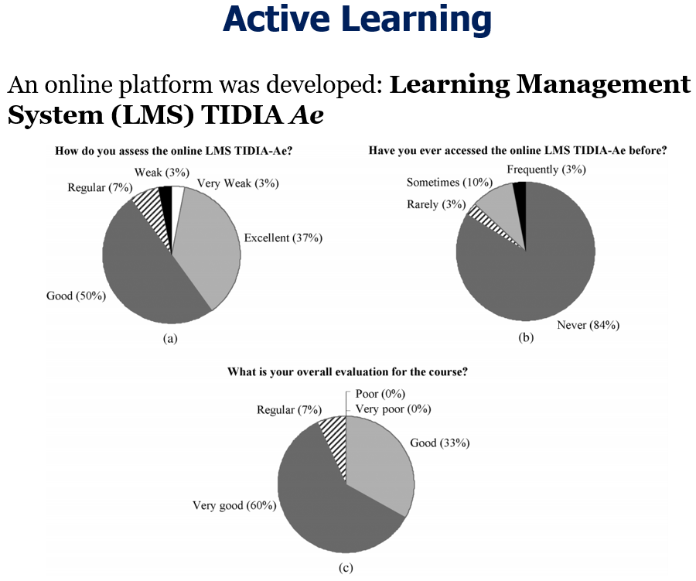
Transportation Engineering Education for Undergraduate Students: Competencies, Skills, Teaching-Learning, and Evaluation
Carlos Alberto Prado da Silva Jr.; Heliana Barbosa Fontenele; Antônio Nélson Rodrigues da Silva
Presented by Somdut Roy for CETL-8713, Spring 2021
Introduction
Civil Engineering
Problems for Transportation Professionals
Most Transportation professionals have bachelor degree in Civil Engineering, only a few take up dedicated graduate studies
Issues with Bachelor curriculum
Inflexible and non-dedicated Curriculum: Curriculum needs to be more flexible, more specific approach in the first years of education
Insufficient “Specialization-specific” Literature: Project and management of transportations systems not covered in texts
Case Study
. The study was performed on a set of courses at University of São Paulo at São Carlos (EESC-USP), Brazil
Resources Applied in the Classroom
Active Learning
An online platform was developed: Learning Management System (LMS) TIDIA Ae
Teaching Style vs Learning Style Preference
Expositive Classes:
Oral presentation
Slideshows
Blackboard Lecture
Guided Computer Lab
Minute Papers:
The students were asked to register, immediately after the classes
They note down topics useful to them
The notes were analyzed
The most relevant points were brought back by the lecturer in subsequent classes.
Analyze
Plan
Do
Review
Constant Questioning:
The lecturer asked students to answer short and direct questions related to the topics discussed during the classes.
The first student selected was then asked to select another student to answer the following question, and so on.
Teamwork:
Groups for small tasks like:
Elaboration of graphs
Resolution of numerical exercises
Construction of simple mathematical models
Tasks were 5-10 min long
Team of two; students take turn to present
Evaluation of Concept Map
Dedicated Courses |  | Experimental Teaching
Set of courses selected to provide focus on Transportation Engineering. |  | Emphasis on teaching-learning strategies for the courses and studying the effectiveness of it
Limitations of Current Study
Questionable universal applicability: Study performed on a limited number of course
Lack of repetition of the experimental learning: Need to do it for considerable amount of time
Difficulty in covering more concepts: As seen in concept map evaluation, student can be introduced to limited number of new concepts under current setting.
Notes:
As we can see, the class structure produced ample opportunity for active learning. They also created an online learning management system.
As you can see in the figure in top right, most of them were not aware of the resource at the beginning of the class.
However as reflected in the pie chart at the top left, 87 percent of students gave a good feedback to the online system.
Looking at the figure at the bottom, it is also insightful that 93 percent of the students gave a good or very good to the courses and there was no negative feedback to talk about.

Slide 9
Transportation Engineering Education for Undergraduate Students: Competencies, Skills, Teaching-Learning, and Evaluation
Carlos Alberto Prado da Silva Jr.; Heliana Barbosa Fontenele; Antônio Nélson Rodrigues da Silva
Presented by Somdut Roy for CETL-8713, Spring 2021
Introduction
Civil Engineering
Problems for Transportation Professionals
Most Transportation professionals have bachelor degree in Civil Engineering, only a few take up dedicated graduate studies
Issues with Bachelor curriculum
Inflexible and non-dedicated Curriculum: Curriculum needs to be more flexible, more specific approach in the first years of education
Insufficient “Specialization-specific” Literature: Project and management of transportations systems not covered in texts
Case Study
. The study was performed on a set of courses at University of São Paulo at São Carlos (EESC-USP), Brazil
Resources Applied in the Classroom
Active Learning
An online platform was developed: Learning Management System (LMS) TIDIA Ae
Teaching Style vs Learning Style Preference
Expositive Classes:
Oral presentation
Slideshows
Blackboard Lecture
Guided Computer Lab
Minute Papers:
The students were asked to register, immediately after the classes
They note down topics useful to them
The notes were analyzed
The most relevant points were brought back by the lecturer in subsequent classes.
Analyze
Plan
Do
Review
Constant Questioning:
The lecturer asked students to answer short and direct questions related to the topics discussed during the classes.
The first student selected was then asked to select another student to answer the following question, and so on.
Teamwork:
Groups for small tasks like:
Elaboration of graphs
Resolution of numerical exercises
Construction of simple mathematical models
Tasks were 5-10 min long
Team of two; students take turn to present
Evaluation of Concept Map
Dedicated Courses |  | Experimental Teaching
Set of courses selected to provide focus on Transportation Engineering. |  | Emphasis on teaching-learning strategies for the courses and studying the effectiveness of it
Limitations of Current Study
Questionable universal applicability: Study performed on a limited number of course
Lack of repetition of the experimental learning: Need to do it for considerable amount of time
Difficulty in covering more concepts: As seen in concept map evaluation, student can be introduced to limited number of new concepts under current setting.

Slide 10
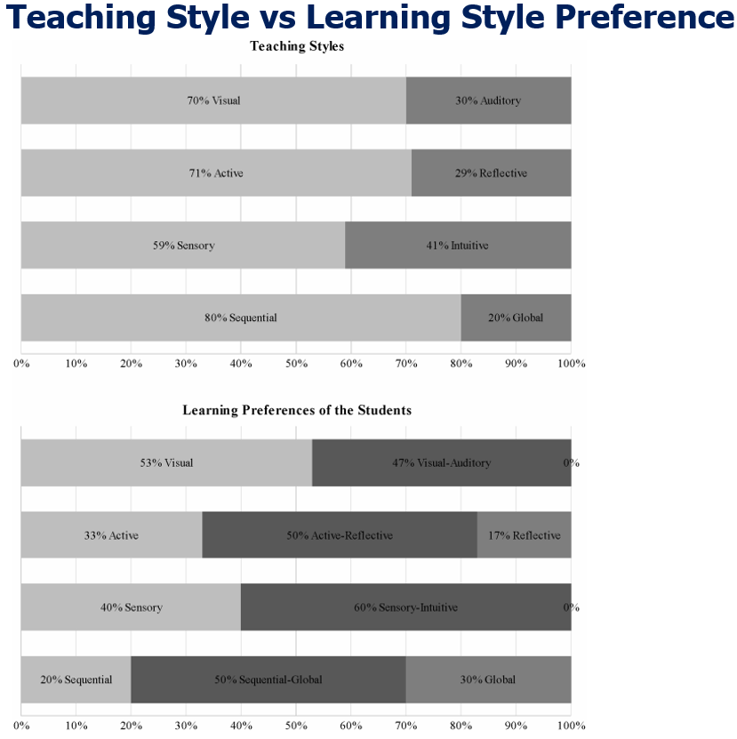
Transportation Engineering Education for Undergraduate Students: Competencies, Skills, Teaching-Learning, and Evaluation
Carlos Alberto Prado da Silva Jr.; Heliana Barbosa Fontenele; Antônio Nélson Rodrigues da Silva
Presented by Somdut Roy for CETL-8713, Spring 2021
Introduction
Civil Engineering
Problems for Transportation Professionals
Most Transportation professionals have bachelor degree in Civil Engineering, only a few take up dedicated graduate studies
Issues with Bachelor curriculum
Inflexible and non-dedicated Curriculum: Curriculum needs to be more flexible, more specific approach in the first years of education
Insufficient “Specialization-specific” Literature: Project and management of transportations systems not covered in texts
Case Study
. The study was performed on a set of courses at University of São Paulo at São Carlos (EESC-USP), Brazil
Resources Applied in the Classroom
Active Learning
An online platform was developed: Learning Management System (LMS) TIDIA Ae
Teaching Style vs Learning Style Preference
Expositive Classes:
Oral presentation
Slideshows
Blackboard Lecture
Guided Computer Lab
Minute Papers:
The students were asked to register, immediately after the classes
They note down topics useful to them
The notes were analyzed
The most relevant points were brought back by the lecturer in subsequent classes.
Analyze
Plan
Do
Review
Constant Questioning:
The lecturer asked students to answer short and direct questions related to the topics discussed during the classes.
The first student selected was then asked to select another student to answer the following question, and so on.
Teamwork:
Groups for small tasks like:
Elaboration of graphs
Resolution of numerical exercises
Construction of simple mathematical models
Tasks were 5-10 min long
Team of two; students take turn to present
Evaluation of Concept Map
Dedicated Courses |  | Experimental Teaching
Set of courses selected to provide focus on Transportation Engineering. |  | Emphasis on teaching-learning strategies for the courses and studying the effectiveness of it
Limitations of Current Study
Questionable universal applicability: Study performed on a limited number of course
Lack of repetition of the experimental learning: Need to do it for considerable amount of time
Difficulty in covering more concepts: As seen in concept map evaluation, student can be introduced to limited number of new concepts under current setting.
Notes:
This survey-based result was shows us how the teaching style was in sync with the learning preferences of the student.
For example, if you look at the second bar graph from the top, the teaching had an almost 70-30 split of active and reflective learning, and based on the student responses, 83 percent of the classes needed to have some form of active learning in them.
This was an encouraging sign for the teachers to extend these techniques to other courses in the future.

Slide 11
Transportation Engineering Education for Undergraduate Students: Competencies, Skills, Teaching-Learning, and Evaluation
Carlos Alberto Prado da Silva Jr.; Heliana Barbosa Fontenele; Antônio Nélson Rodrigues da Silva
Presented by Somdut Roy for CETL-8713, Spring 2021
Introduction
Civil Engineering
Problems for Transportation Professionals
Most Transportation professionals have bachelor degree in Civil Engineering, only a few take up dedicated graduate studies
Issues with Bachelor curriculum
Inflexible and non-dedicated Curriculum: Curriculum needs to be more flexible, more specific approach in the first years of education
Insufficient “Specialization-specific” Literature: Project and management of transportations systems not covered in texts
Case Study
. The study was performed on a set of courses at University of São Paulo at São Carlos (EESC-USP), Brazil
Resources Applied in the Classroom
Active Learning
An online platform was developed: Learning Management System (LMS) TIDIA Ae
Teaching Style vs Learning Style Preference
Expositive Classes:
Oral presentation
Slideshows
Blackboard Lecture
Guided Computer Lab
Minute Papers:
The students were asked to register, immediately after the classes
They note down topics useful to them
The notes were analyzed
The most relevant points were brought back by the lecturer in subsequent classes.
Analyze
Plan
Do
Review
Constant Questioning:
The lecturer asked students to answer short and direct questions related to the topics discussed during the classes.
The first student selected was then asked to select another student to answer the following question, and so on.
Teamwork:
Groups for small tasks like:
Elaboration of graphs
Resolution of numerical exercises
Construction of simple mathematical models
Tasks were 5-10 min long
Team of two; students take turn to present
Evaluation of Concept Map
Dedicated Courses |  | Experimental Teaching
Set of courses selected to provide focus on Transportation Engineering. |  | Emphasis on teaching-learning strategies for the courses and studying the effectiveness of it
Limitations of Current Study
Questionable universal applicability: Study performed on a limited number of course
Lack of repetition of the experimental learning: Need to do it for considerable amount of time
Difficulty in covering more concepts: As seen in concept map evaluation, student can be introduced to limited number of new concepts under current setting.

Slide 12
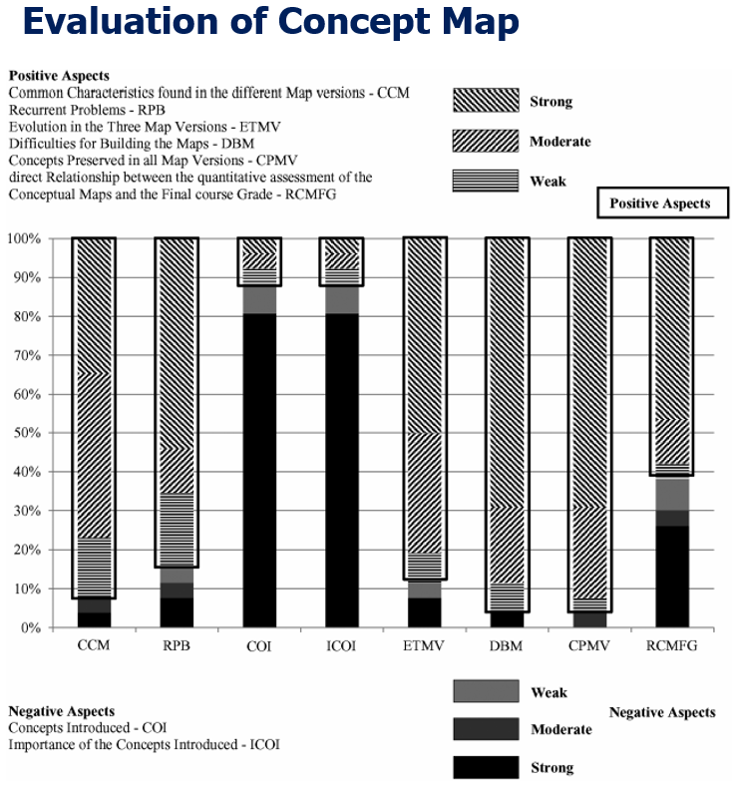
Transportation Engineering Education for Undergraduate Students: Competencies, Skills, Teaching-Learning, and Evaluation
Carlos Alberto Prado da Silva Jr.; Heliana Barbosa Fontenele; Antônio Nélson Rodrigues da Silva
Presented by Somdut Roy for CETL-8713, Spring 2021
Introduction
Civil Engineering
Problems for Transportation Professionals
Most Transportation professionals have bachelor degree in Civil Engineering, only a few take up dedicated graduate studies
Issues with Bachelor curriculum
Inflexible and non-dedicated Curriculum: Curriculum needs to be more flexible, more specific approach in the first years of education
Insufficient “Specialization-specific” Literature: Project and management of transportations systems not covered in texts
Case Study
. The study was performed on a set of courses at University of São Paulo at São Carlos (EESC-USP), Brazil
Resources Applied in the Classroom
Active Learning
An online platform was developed: Learning Management System (LMS) TIDIA Ae
Teaching Style vs Learning Style Preference
Expositive Classes:
Oral presentation
Slideshows
Blackboard Lecture
Guided Computer Lab
Minute Papers:
The students were asked to register, immediately after the classes
They note down topics useful to them
The notes were analyzed
The most relevant points were brought back by the lecturer in subsequent classes.
Analyze
Plan
Do
Review
Constant Questioning:
The lecturer asked students to answer short and direct questions related to the topics discussed during the classes.
The first student selected was then asked to select another student to answer the following question, and so on.
Teamwork:
Groups for small tasks like:
Elaboration of graphs
Resolution of numerical exercises
Construction of simple mathematical models
Tasks were 5-10 min long
Team of two; students take turn to present
Evaluation of Concept Map
Dedicated Courses |  | Experimental Teaching
Set of courses selected to provide focus on Transportation Engineering. |  | Emphasis on teaching-learning strategies for the courses and studying the effectiveness of it
Limitations of Current Study
Questionable universal applicability: Study performed on a limited number of course
Lack of repetition of the experimental learning: Need to do it for considerable amount of time
Difficulty in covering more concepts: As seen in concept map evaluation, student can be introduced to limited number of new concepts under current setting.
Notes:
Here are some more results. The graphs show us the positive and negative aspects of different factors for the concept maps used in class.
The shaded regions reflect positive aspects and the dark colored regions reflect negative aspects.
Most of the factors yielded a net positive.
Only two of them showing negative response in the current setting: (1) Concepts Introduced and (2) Importance of Concepts Introduced. That means, students had a hard time when a new concept was introduced and also they had a difficult time to realize the importance of the new concept introduced in the middle of the class
This shows that with the current teaching experimentations, there was associated difficulty when we added new concepts in the courses.
However, in my opinion this could also be because the students were new to this method of teaching.

Slide 13
Transportation Engineering Education for Undergraduate Students: Competencies, Skills, Teaching-Learning, and Evaluation
Carlos Alberto Prado da Silva Jr.; Heliana Barbosa Fontenele; Antônio Nélson Rodrigues da Silva
Presented by Somdut Roy for CETL-8713, Spring 2021
Introduction
Civil Engineering
Problems for Transportation Professionals
Most Transportation professionals have bachelor degree in Civil Engineering, only a few take up dedicated graduate studies
Issues with Bachelor curriculum
Inflexible and non-dedicated Curriculum: Curriculum needs to be more flexible, more specific approach in the first years of education
Insufficient “Specialization-specific” Literature: Project and management of transportations systems not covered in texts
Case Study
. The study was performed on a set of courses at University of São Paulo at São Carlos (EESC-USP), Brazil
Resources Applied in the Classroom
Active Learning
An online platform was developed: Learning Management System (LMS) TIDIA Ae
Teaching Style vs Learning Style Preference
Expositive Classes:
Oral presentation
Slideshows
Blackboard Lecture
Guided Computer Lab
Minute Papers:
The students were asked to register, immediately after the classes
They note down topics useful to them
The notes were analyzed
The most relevant points were brought back by the lecturer in subsequent classes.
Analyze
Plan
Do
Review
Constant Questioning:
The lecturer asked students to answer short and direct questions related to the topics discussed during the classes.
The first student selected was then asked to select another student to answer the following question, and so on.
Teamwork:
Groups for small tasks like:
Elaboration of graphs
Resolution of numerical exercises
Construction of simple mathematical models
Tasks were 5-10 min long
Team of two; students take turn to present
Evaluation of Concept Map
Dedicated Courses |  | Experimental Teaching
Set of courses selected to provide focus on Transportation Engineering. |  | Emphasis on teaching-learning strategies for the courses and studying the effectiveness of it
Limitations of Current Study
Questionable universal applicability: Study performed on a limited number of course
Lack of repetition of the experimental learning: Need to do it for considerable amount of time
Difficulty in covering more concepts: As seen in concept map evaluation, student can be introduced to limited number of new concepts under current setting.

Slide 14
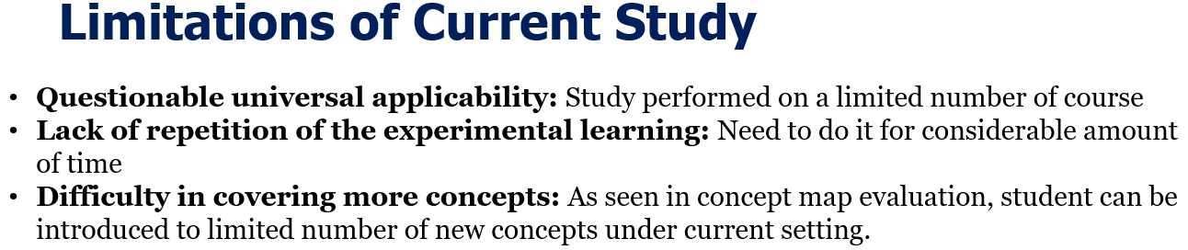
Transportation Engineering Education for Undergraduate Students: Competencies, Skills, Teaching-Learning, and Evaluation
Carlos Alberto Prado da Silva Jr.; Heliana Barbosa Fontenele; Antônio Nélson Rodrigues da Silva
Presented by Somdut Roy for CETL-8713, Spring 2021
Introduction
Civil Engineering
Problems for Transportation Professionals
Most Transportation professionals have bachelor degree in Civil Engineering, only a few take up dedicated graduate studies
Issues with Bachelor curriculum
Inflexible and non-dedicated Curriculum: Curriculum needs to be more flexible, more specific approach in the first years of education
Insufficient “Specialization-specific” Literature: Project and management of transportations systems not covered in texts
Case Study
. The study was performed on a set of courses at University of São Paulo at São Carlos (EESC-USP), Brazil
Resources Applied in the Classroom
Active Learning
An online platform was developed: Learning Management System (LMS) TIDIA Ae
Teaching Style vs Learning Style Preference
Expositive Classes:
Oral presentation
Slideshows
Blackboard Lecture
Guided Computer Lab
Minute Papers:
The students were asked to register, immediately after the classes
They note down topics useful to them
The notes were analyzed
The most relevant points were brought back by the lecturer in subsequent classes.
Analyze
Plan
Do
Review
Constant Questioning:
The lecturer asked students to answer short and direct questions related to the topics discussed during the classes.
The first student selected was then asked to select another student to answer the following question, and so on.
Teamwork:
Groups for small tasks like:
Elaboration of graphs
Resolution of numerical exercises
Construction of simple mathematical models
Tasks were 5-10 min long
Team of two; students take turn to present
Evaluation of Concept Map
Dedicated Courses |  | Experimental Teaching
Set of courses selected to provide focus on Transportation Engineering. |  | Emphasis on teaching-learning strategies for the courses and studying the effectiveness of it
Limitations of Current Study
Questionable universal applicability: Study performed on a limited number of course
Lack of repetition of the experimental learning: Need to do it for considerable amount of time
Difficulty in covering more concepts: As seen in concept map evaluation, student can be introduced to limited number of new concepts under current setting.
Notes:
In summary, while this teaching setting had so much positives, we still need to see the results over time.
Also, we would need to use the techniques expensively to make statistically significant improvement claims.
As we saw in the bar graph presentation, this teaching system has a hard time to introduce and maintain new concepts.
That creates a tradeoff between the extent of teaching material that you can cover and the amount of retention the learners have from a class.
So, this leaves us with opportunity to tweak certain aspects of it to perfectly fit the necessity of a discipline.

Slide 15
Transportation Engineering Education for Undergraduate Students: Competencies, Skills, Teaching-Learning, and Evaluation
Carlos Alberto Prado da Silva Jr.; Heliana Barbosa Fontenele; Antônio Nélson Rodrigues da Silva
Presented by Somdut Roy for CETL-8713, Spring 2021
Introduction
Civil Engineering
Problems for Transportation Professionals
Most Transportation professionals have bachelor degree in Civil Engineering, only a few take up dedicated graduate studies
Issues with Bachelor curriculum
Inflexible and non-dedicated Curriculum: Curriculum needs to be more flexible, more specific approach in the first years of education
Insufficient “Specialization-specific” Literature: Project and management of transportations systems not covered in texts
Case Study
. The study was performed on a set of courses at University of São Paulo at São Carlos (EESC-USP), Brazil
Resources Applied in the Classroom
Active Learning
An online platform was developed: Learning Management System (LMS) TIDIA Ae
Teaching Style vs Learning Style Preference
Expositive Classes:
Oral presentation
Slideshows
Blackboard Lecture
Guided Computer Lab
Minute Papers:
The students were asked to register, immediately after the classes
They note down topics useful to them
The notes were analyzed
The most relevant points were brought back by the lecturer in subsequent classes.
Analyze
Plan
Do
Review
Constant Questioning:
The lecturer asked students to answer short and direct questions related to the topics discussed during the classes.
The first student selected was then asked to select another student to answer the following question, and so on.
Teamwork:
Groups for small tasks like:
Elaboration of graphs
Resolution of numerical exercises
Construction of simple mathematical models
Tasks were 5-10 min long
Team of two; students take turn to present
Evaluation of Concept Map
Dedicated Courses |  | Experimental Teaching
Set of courses selected to provide focus on Transportation Engineering. |  | Emphasis on teaching-learning strategies for the courses and studying the effectiveness of it
Limitations of Current Study
Questionable universal applicability: Study performed on a limited number of course
Lack of repetition of the experimental learning: Need to do it for considerable amount of time
Difficulty in covering more concepts: As seen in concept map evaluation, student can be introduced to limited number of new concepts under current setting.
Notes:
Thanks for your time.

